Slide 1
Two Questions
How do I find the good stuff?
And how do I use the good stuff?
A: gft_predict

Slide 2
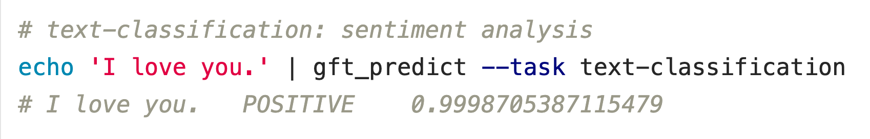



Question: How do I use the good stuff? Answer: gft_predict
$$f\left(x\right)→\hat{y}$$
No model specified
$$x$$
$$\hat{y}$$
Score

Slide 3
Input: I love you Output: Depends on Model (among other things)
Task: classify
Models:
Sentiment
Expected output label: positive
Fake News:
Expected output label: not fake (real)
Spam/Ham:
Expected output label: not spam (ham)
for model in …
do
echo I love you |
gft_predict \
--task classify \
--model $model
done

Slide 4
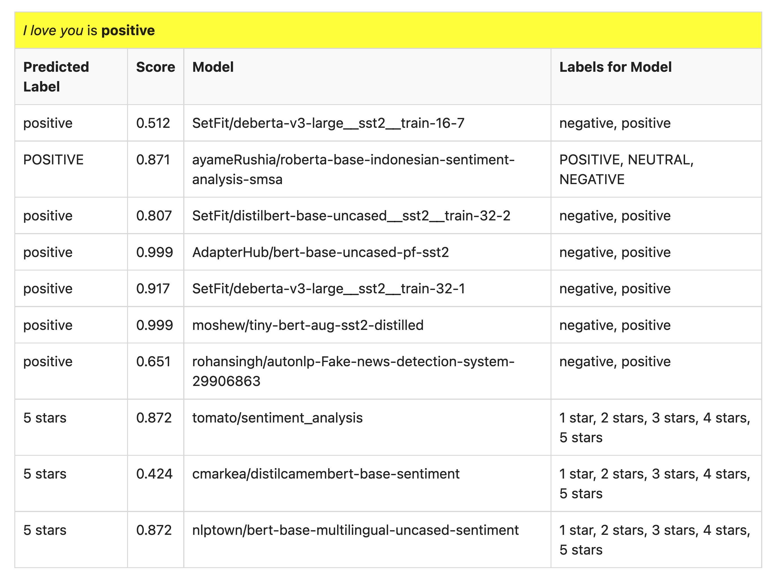
Many of these models produce reasonable results
Scores could be more confident

Slide 5
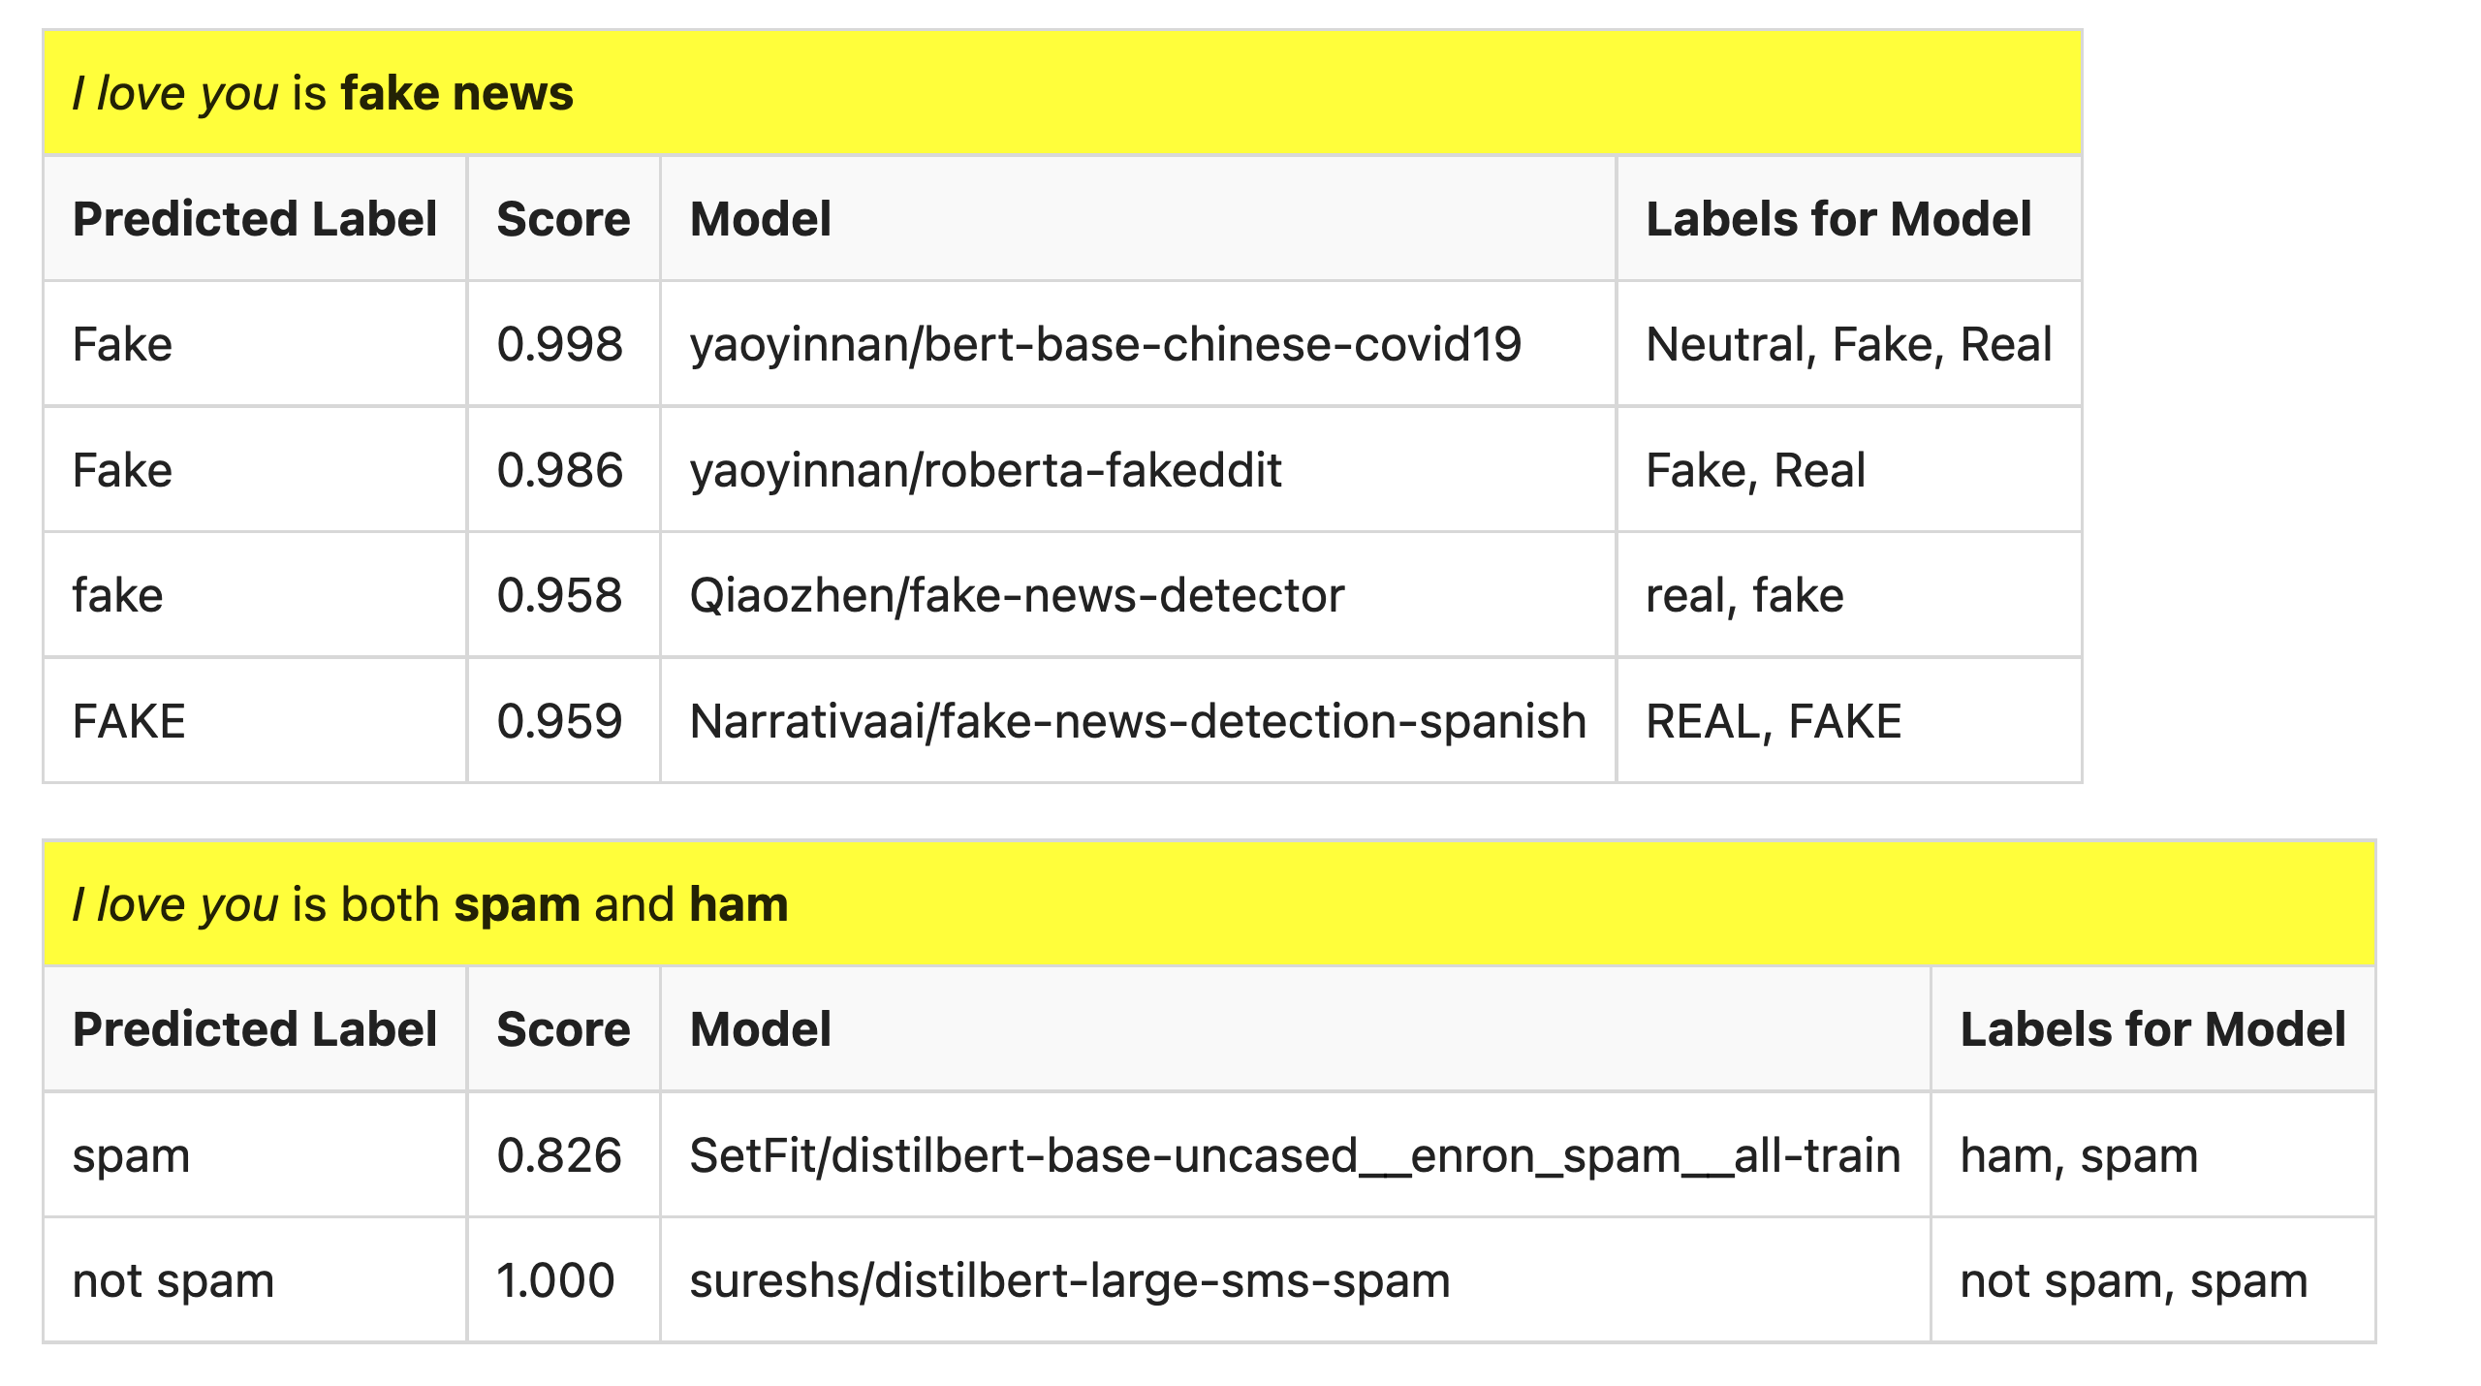
But…

Slide 6
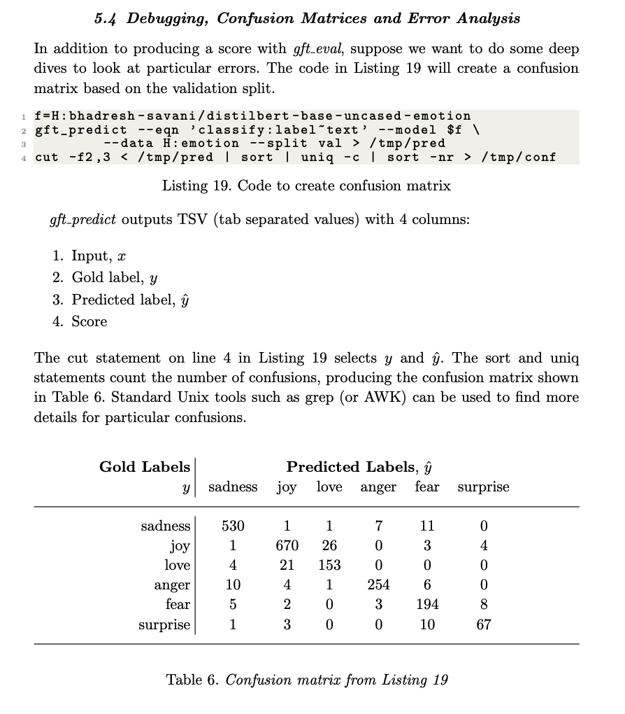
Debugging, Confusion Matrices & Error Analysis

Slide 7
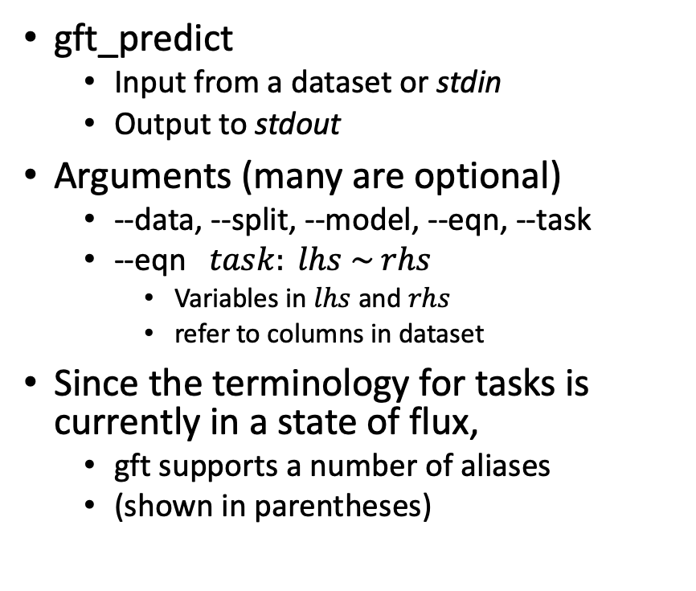
Inference: gft_predict
gft_predict
Input from a dataset or stdin
Output to stdout
Arguments (many are optional)
--data, --split, --model, --eqn, --task
--eqn $task: lhs \sim rhs$
Variables in $lhs$ and $rhs$
refer to columns in dataset
Since the terminology for tasks is currently in a state of flux,
gft supports a number of aliases
(shown in parentheses)
Tasks (aliases in parenthesis)
classify (text-classification)
classify_tokens
(token-classification)
classify_spans
(QA, question-answering)
classify_audio (audio-classification)
classify_images (image-classification)
regress
text-generation
MT (translation)
ASR
(ctc, automatic-speech-recognition)
fill-mask

Slide 8
Agenda: Part A
Strategy
gft Cheatsheet
4-5 Functions + 4 Arguments
Amazing how much can be done with so little
Seven Simple Examples
More Tasks: MT, ASR, Vision
Two Questions
How do we find the good stuff?
How do we use the good stuff?
Why de-emphasize pre-training?
Conclusions

Slide 9
Why De-emphasize Pre-Training?

Slide 10
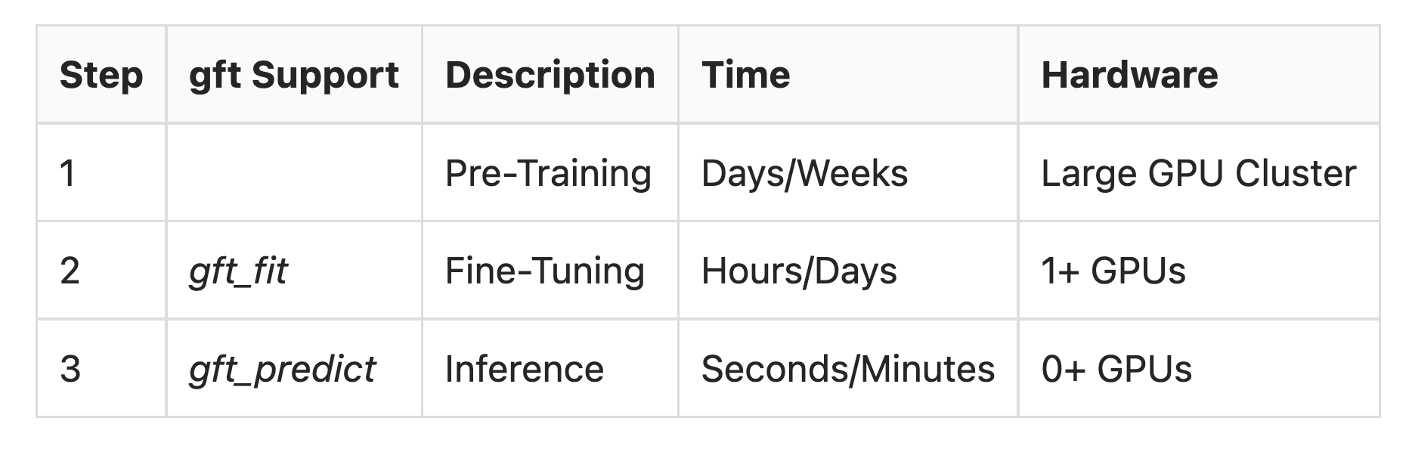
Standard 3-Step Recipe
One-Time
$$$$
(Cost)
Recurring
$
less cost;
more profit

Slide 11
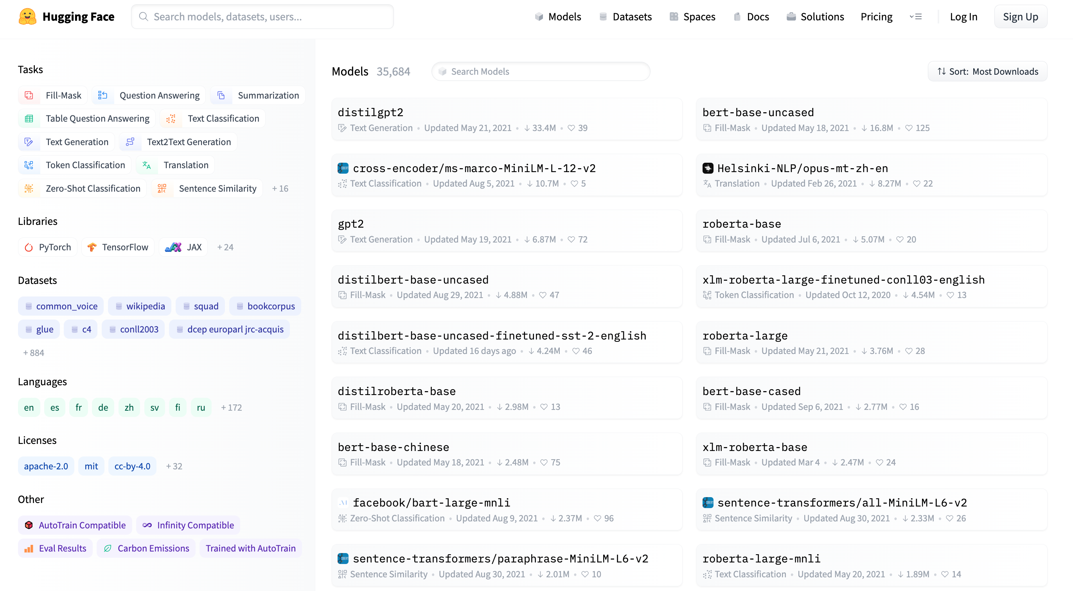
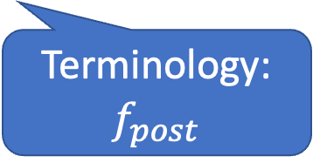
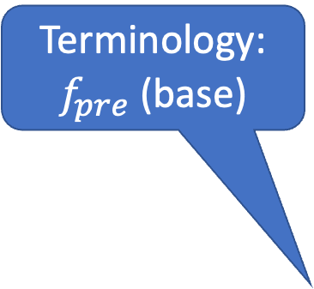
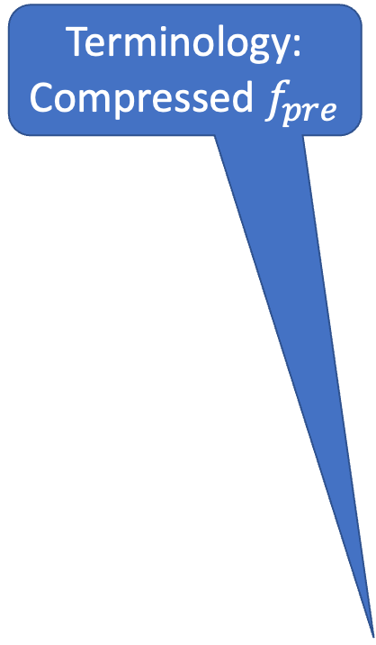

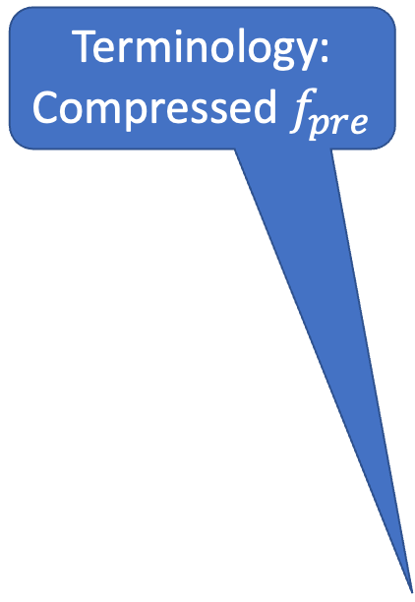
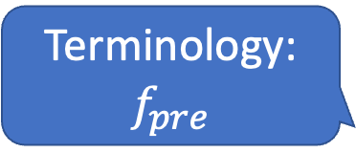
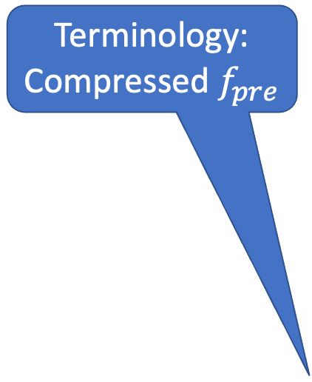

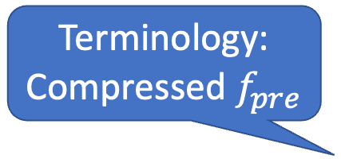
Models https://huggingface.co/models
Terminology:
$$f,f_{pre},f_{post}$$
Terminology:
Compressed $f_{pre}$
Terminology:
Compressed $f_{pre}$
Terminology:
Compressed $f_{pre}$
Terminology:
Compressed $f_{pre}$
Terminology:
$f_{pre}$ (base)
Terminology:
$$f_{pre}$$
Terminology:
$$f_{post}$$
Terminology:
$$f_{pre}$$

Slide 12
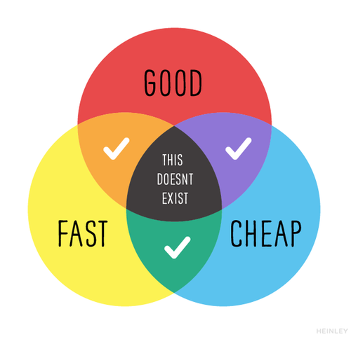
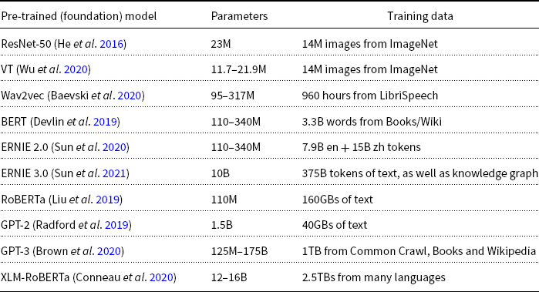
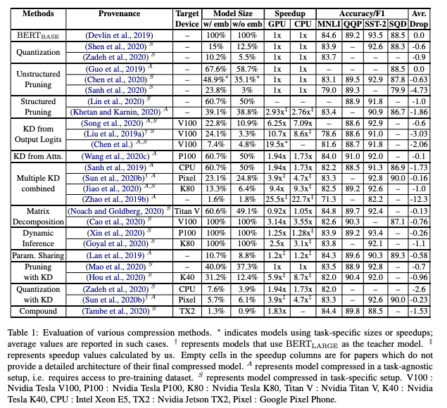
Model Compression (Distillation): Important for Commercial Practice
Popular Choices on Hubs
Model Compression:
Trade-offs: Size vs. Accuracy
Pick any two
Compressed
https://arxiv.org/pdf/2002.11985.pdf
Compressed

Slide 13
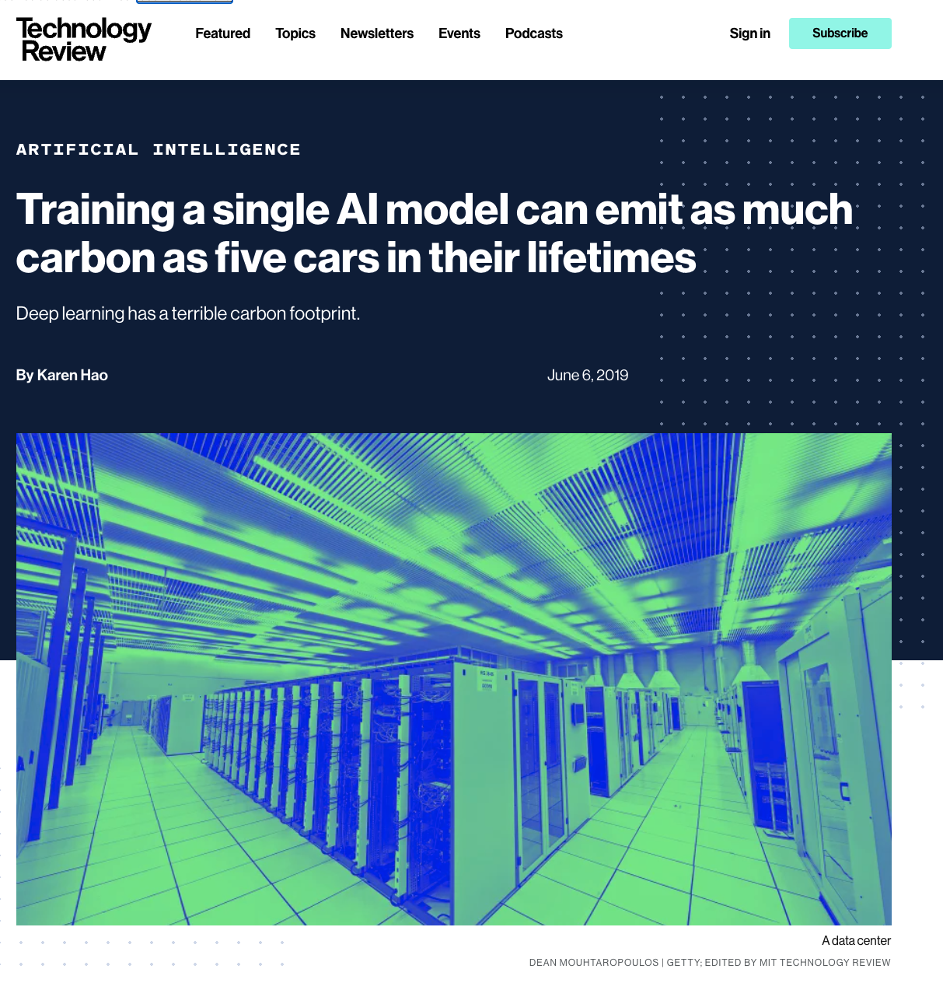
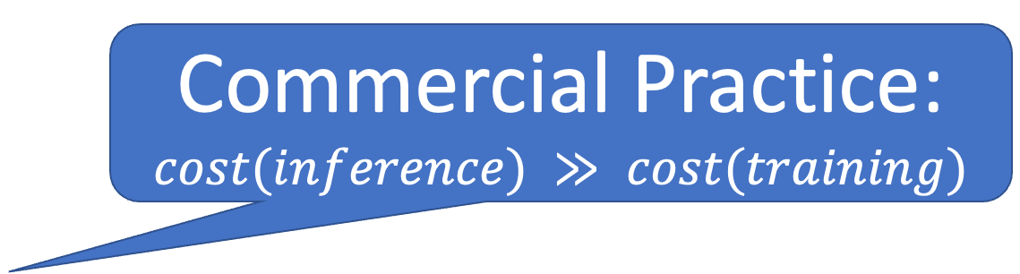
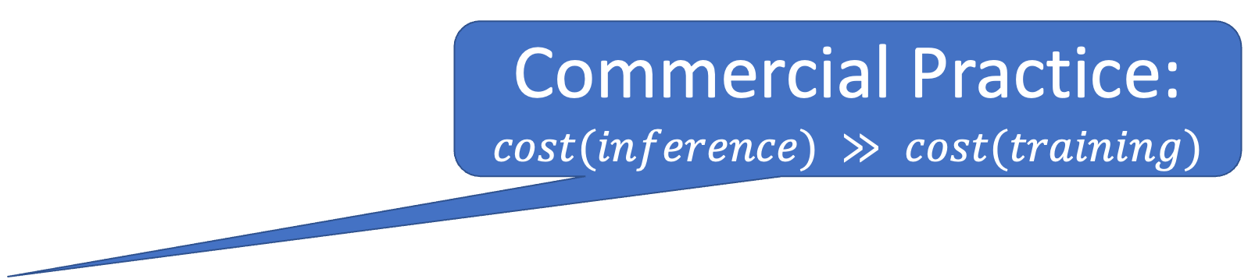
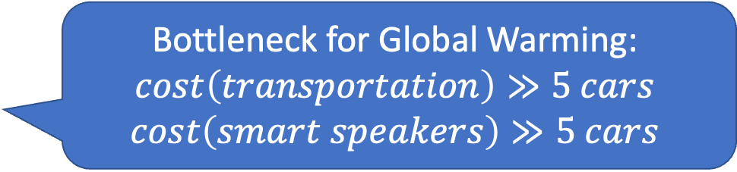
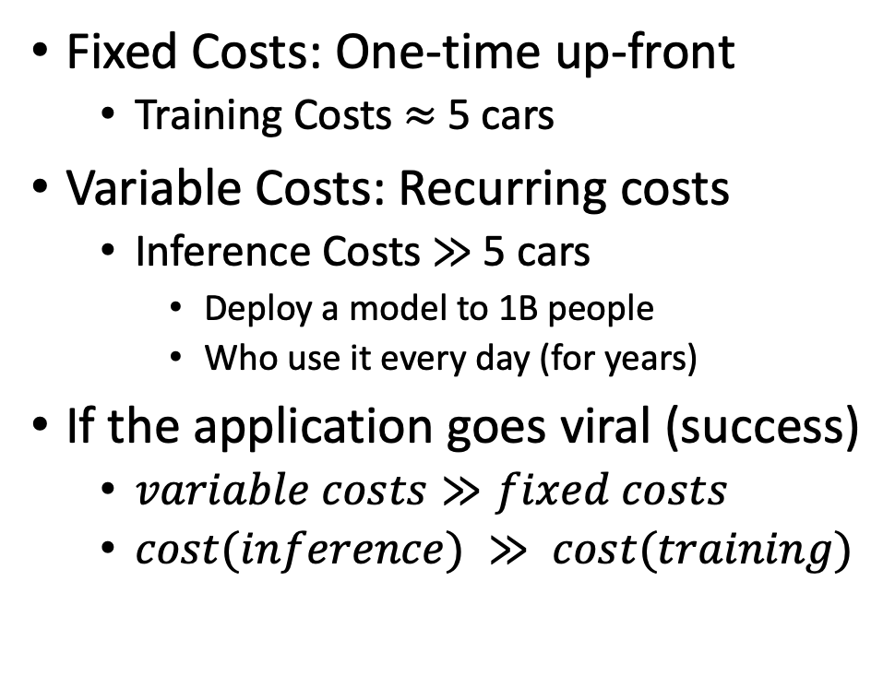
Lesson: Focus on Bottlenecks
Bottleneck for Global Warming:
$$cost\left(transportation\right)≫5 cars$$
$$cost\left(smart speakers\right)≫5 cars$$
Commercial Practice: $cost(inference) ≫ cost(training)$
Commercial Practice: $cost(inference) ≫ cost(training)$
Fixed Costs: One-time up-front
Training Costs $≈$5 cars
Variable Costs: Recurring costs
Inference Costs $≫$5 cars
Deploy a model to 1B people
Who use it every day (for years)
If the application goes viral (success)
$variable costs≫fixed costs$
$cost(inference) ≫ cost(training)$
Relatively small

Slide 14
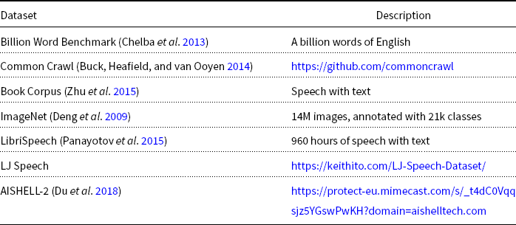
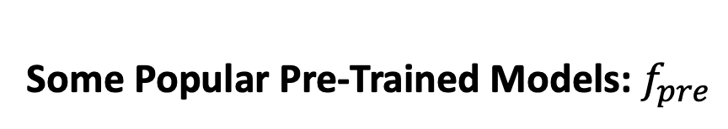
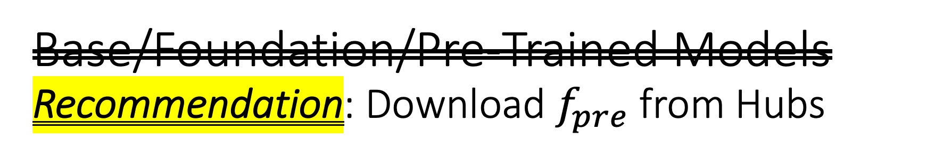
Base/Foundation/Pre-Trained Models Recommendation: Download $f_{pre}$from Hubs
Some Popular Pre-Trained Models: $f_{pre}$
Some Popular Datasets for Pre-Training
DDI → Don’t Do It (yourself)

Slide 15
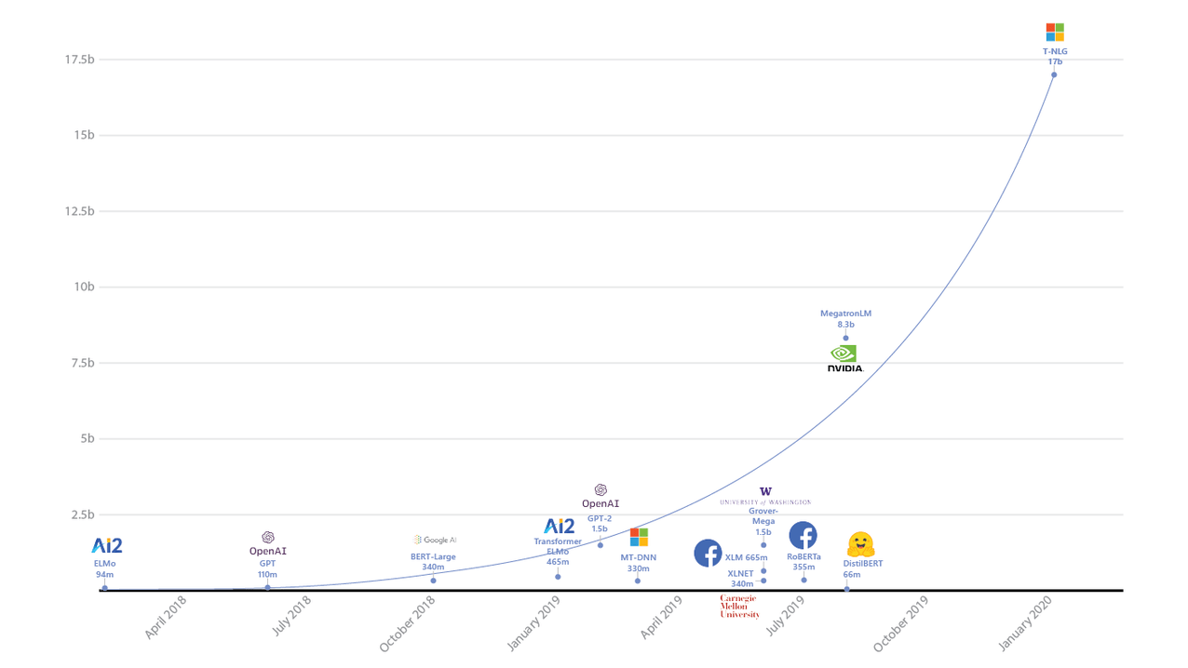
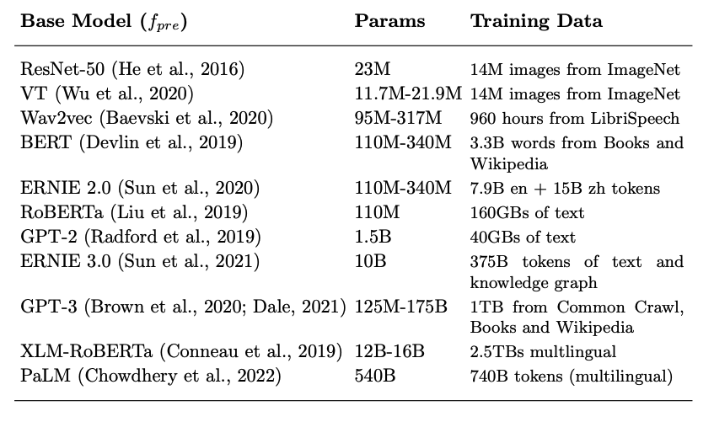
Bigger Models are Better (but less efficient)
Data Source: Microsoft blog (https://syncedreview.com/2020/02/12/17-billion-parameters-microsoft-deepspeed-breeds-worlds-largest-nlp-model/) and Kunle Olukton’s presentation at ScaledML
Industry-only
(too expective for academia)
Industry-only
(too expensive for academia)
17b Parameters
1000 GPUs
6% efficiency
8b Parameters
512 GPUs
20% efficiency

Slide 16
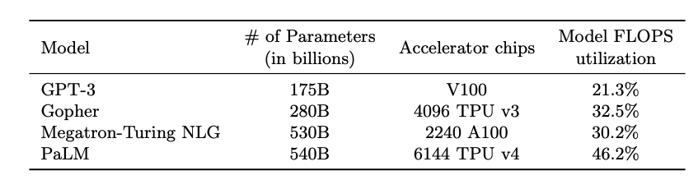
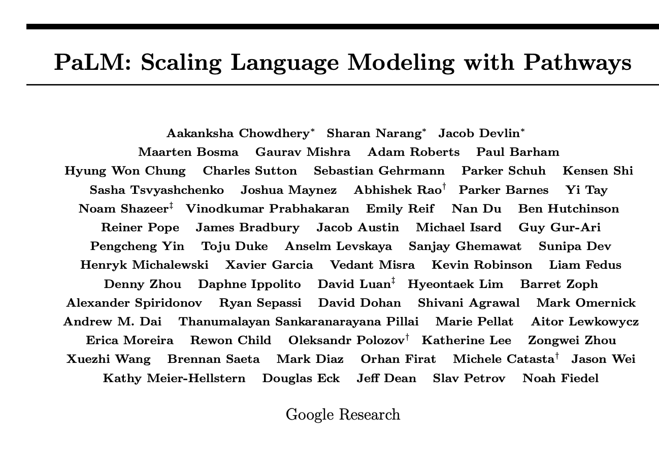
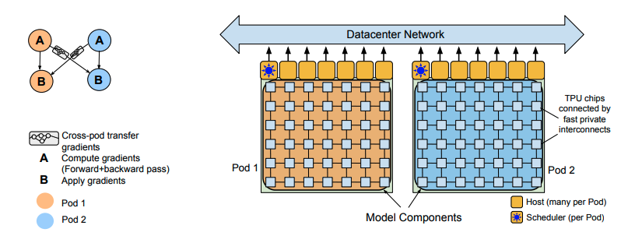
540B Parameters: https://arxiv.org/pdf/2204.02311.pdf
Industry-only
(too expective for academia)

Slide 17
Bigger Models are Better (but less efficient)
Data Source: Microsoft blog (https://syncedreview.com/2020/02/12/17-billion-parameters-microsoft-deepspeed-breeds-worlds-largest-nlp-model/) and Kunle Olukton’s presentation at ScaledML
Industry-only
(too expective for academia)
Industry-only
(too expective for academia)
17b Parameters
1000 GPUs
6% efficiency
8b Parameters
512 GPUs
20% efficiency

Slide 18
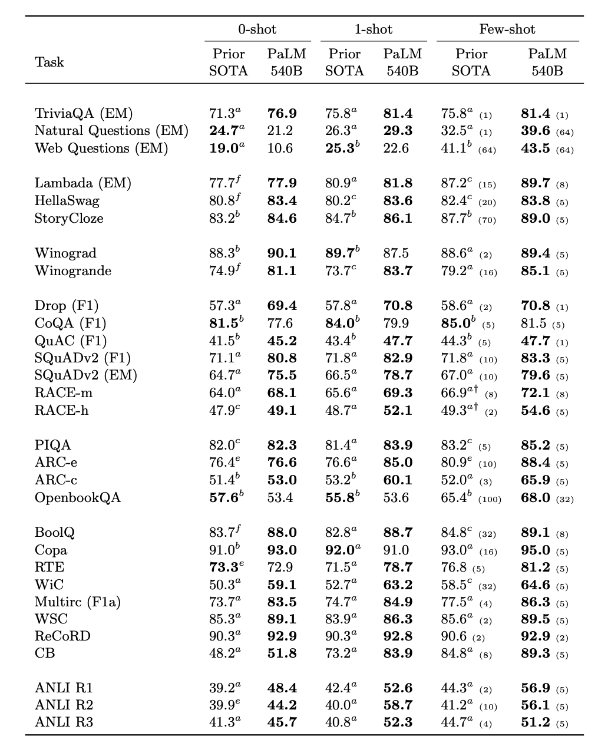
540B Parameters: More Parameters → Better Scores More Supervision → Better Scores

Slide 19
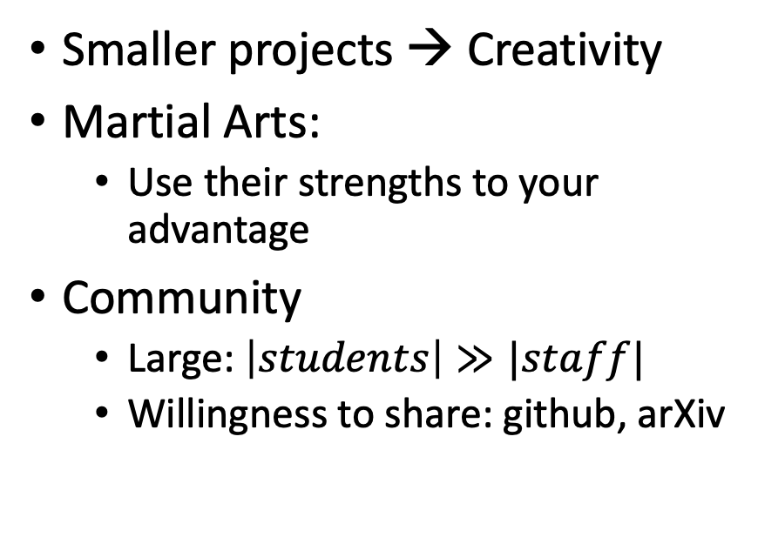
Strengths and Opportunities
Industrial Scale SOTA-Chasing
Opportunities for the Masses
Strengths
$$
Staff (size of staff)
Logistics
Weaknesses
Risk-adverse
Big $$ → Too Big to Fail
Smaller projects → Creativity
Martial Arts:
Use their strengths to your advantage
Community
Large: $\left|students\right|≫|staff|$
Willingness to share: github, arXiv
Standards!!
(Builds Community)
Examples: PyTorch, gft

Slide 20
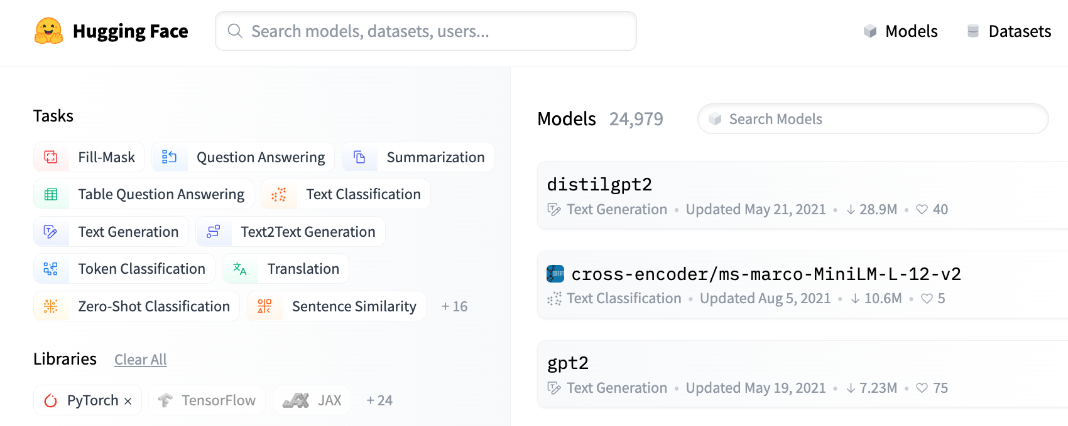
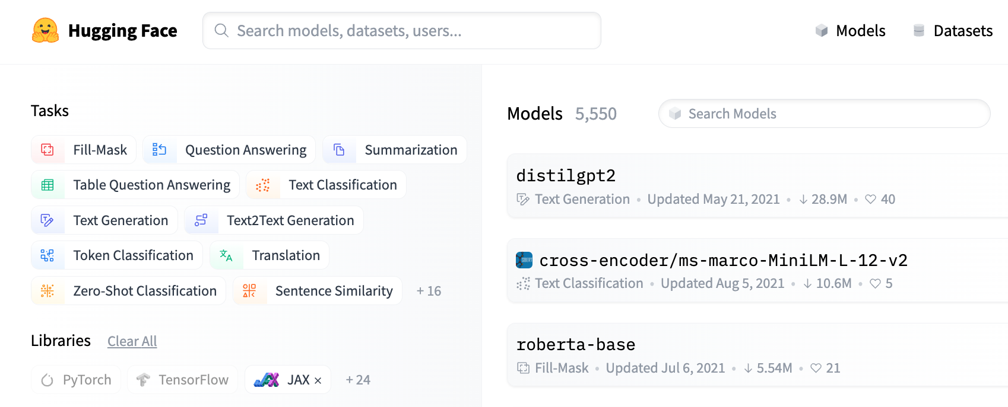

Hubs: PyTorch is Popular ($25k≫6k$) On HuggingFace, PyTorch > JAX > TensorFlow
Ease-of-Use >> System Performance
25k PyTorch Models
6k JAX Models

Slide 21

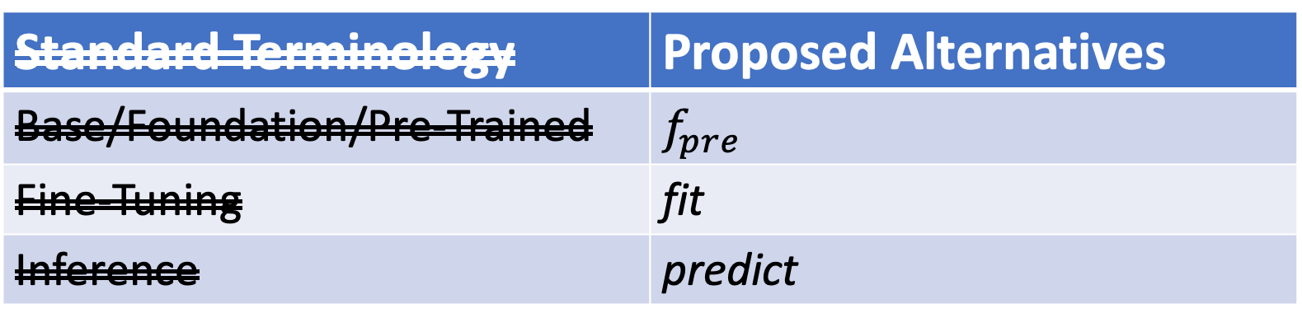
Why Change Terminology?
More opportunity for academics
& Computational Linguistics
Standard Terminology | Proposed Alternatives
Base/Foundation/Pre-Trained | $$f_{pre}$$
Fine-Tuning | fit
Inference | predict
Not this
Emphasize this
Emphasize this
https://www.youtube.com/watch?v=dG628PEN1fY
Industry has an ``unfair advantage’’ over academia
Pre-training requires $$$$, Big Data & Logistics:
Big Investments → Risk Adverse → Less Creativity

Slide 22
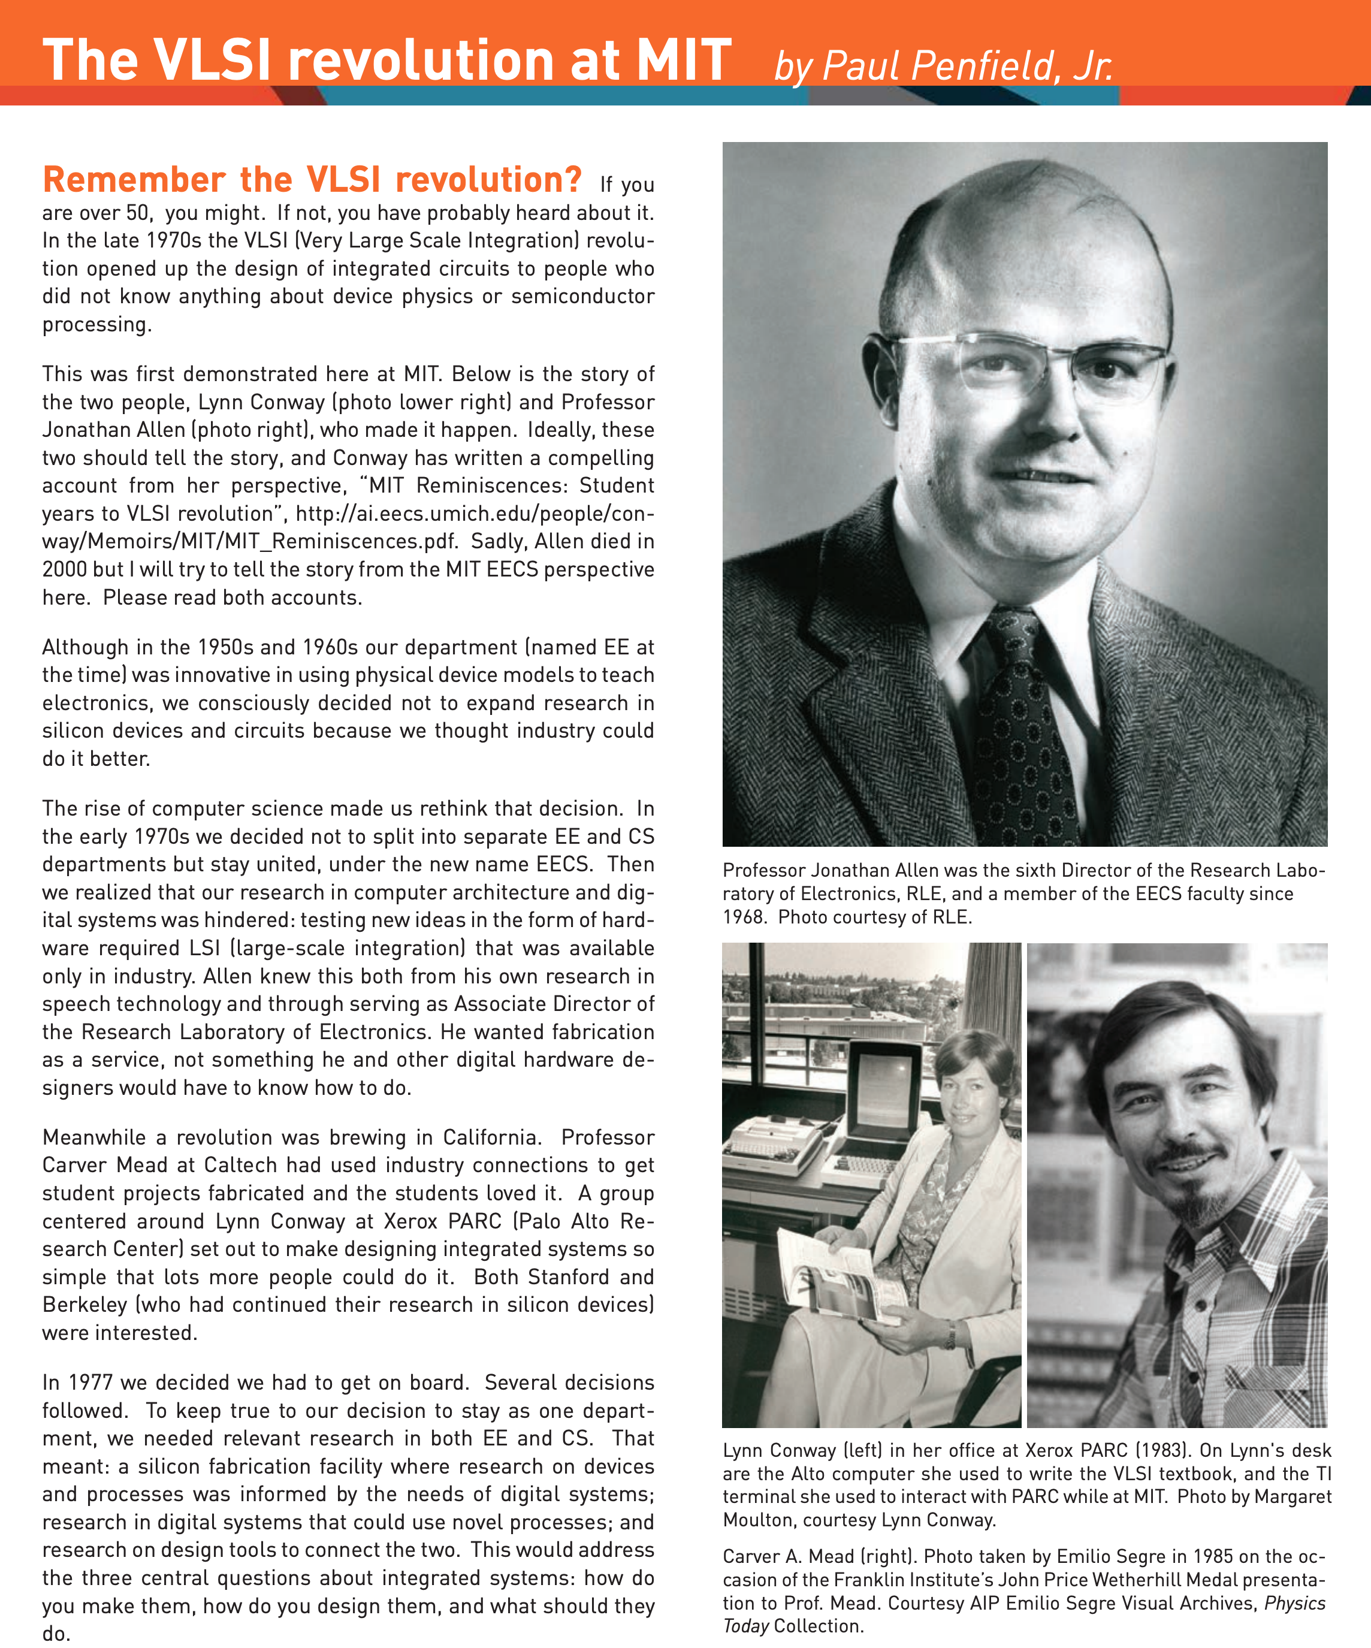
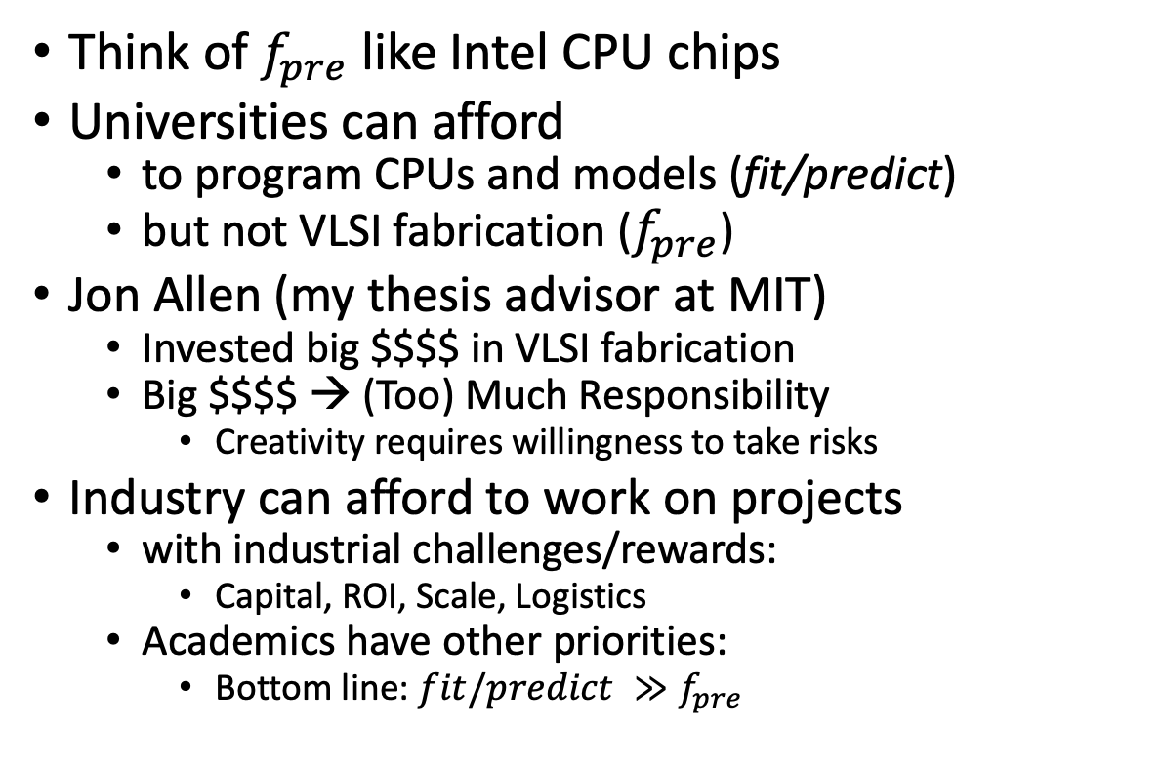
VLSI History http://www.eecs.mit.edu/docs/newsletter/VLSI.pdf http://ai.eecs.umich.edu/people/conway/Memoirs/MIT/MIT_Reminiscences.pdf
Perspective from MIT and beyond:
IBM, Silicon Valley, Mich, LGBTQ, etc.
Think of $f_{pre}$ like Intel CPU chips
Universities can afford
to program CPUs and models (fit/predict)
but not VLSI fabrication ($f_{pre}$)
Jon Allen (my thesis advisor at MIT)
Invested big $$$$ in VLSI fabrication
Big $$$$ → (Too) Much Responsibility
Creativity requires willingness to take risks
Industry can afford to work on projects
with industrial challenges/rewards:
Capital, ROI, Scale, Logistics
Academics have other priorities:
Bottom line: $fit/predict ≫f_{pre}$

Slide 23
Agenda: Part A
Strategy
gft Cheatsheet
4-5 Functions + 4 Arguments
Amazing how much can be done with so little
Seven Simple Examples
More Tasks: MT, ASR, Vision
Two Questions
How do we find the good stuff?
How do we use the good stuff?
Why de-emphasize pre-training?
Conclusions

Slide 24
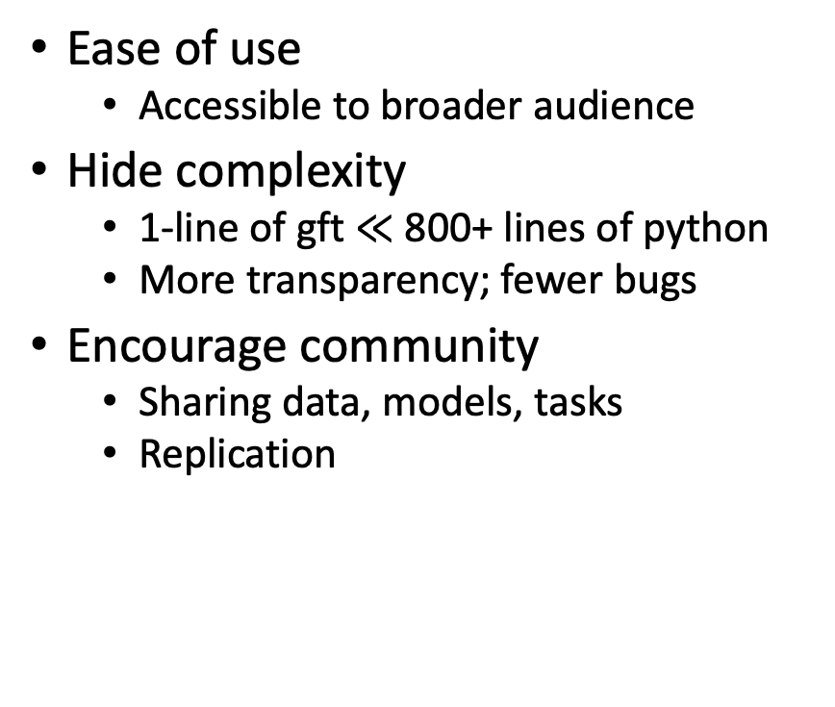
Advantages of Higher-Level Little Languages
Ease of use
Accessible to broader audience
Hide complexity
1-line of gft $≪$ 800+ lines of python
More transparency; fewer bugs
Encourage community
Sharing data, models, tasks
Replication
Avoid special cases
Standard examples on hubs
expect users to modify python
different programs for different datasets/models/tasks
gft encourages code re-use
gft uses same code as examples
with same performance and computational costs
but generalizes over more datasets/models/tasks
Portability across suppliers
Mix and Match Across Hubs
(HuggingFace, PaddleNLP)

Slide 25
Part A Conclusions
See github for code & examples
Amazing how much can be done with so little
Higher level (little) languages like gft have many advantages over examples found on hubs:
Short (1-line) programs are
easier to read and write,
more transparent and
more portable (across hubs)
Inclusiveness
Accessible to masses
Demystify deep nets
No one would suggest regression-like methods are ``intelligent’’
Teaser for Part B:
To improve over Part A, we recommend Interdisciplinary combo
Deep Nets (recent progress)
AI Representation (decades)
Linguistics & Philosophy (centuries)

